Slide 1
Access to information and health care services for overseas Vietnamese labour migrants during COVID-19 pandemic
Aiko Kaji, MPH, PhD
Tran Thi Tuyet Luong, MD, MPH
Nguyen Trang, MSW, PhD

Slide 2
Research objective
To better understand overseas Vietnamese labour migrants’ experiences about accessing accurate health information as well as health-care during public health crises such as COVID-19.

Slide 3
Research questions - Knowledge
What are the factors associated with the knowledge of Vietnamese labour migrants about COVID-19 symptoms, its modes of transmission, and prevention measures issued by the destination country?
What types of health and immigration related information do Vietnamese labour migrants abroad receive during the COVID-19 pandemic?
What communication channels do Vietnamese labour migrants abroad utilize to collect such information?

Slide 4
Research questions – Health care seeking behavior
What are the factors associated with the health care seeking behavior of Vietnamese labour migrants before and during COVID-19 pandemic?

Slide 5
Research questions – Challenges in accessing information and health care services and their enabling factors during the COVID-19 pandemic
What are the challenges overseas Vietnamese labour migrants have faced in accessing healthcare including gender-sensitive healthcare, and health and immigration related information?
What has helped overseas Vietnamese labour migrants find health and immigration related information and healthcare services?
What do key stakeholders perceive to be the most important barriers to health and immigration related information and healthcare services for Vietnamese labour migrants?

Slide 6
Study design
Mixed methods
Quantitative component: online survey among overseas migrants in ROK and Japan
Qualitative component: in-depth interviews with overseas Vietnamese labour migrants in ROK and Japan, and returnees from the two countries and Taiwan Province of PRC. Stakeholders in ROK, Japan and Viet Nam were approached to join the study.
Data collection from July 2021 to Nov 2021

Slide 7
Study population in the quantitative component
Vietnamese labour migrants who (1) are age over 18; (2) are Vietnamese nationals; (3) moved to Japan or ROK before the pandemic; and (4) reside in the destination country at the time of the survey.
In ROK – only EPS workers (except fishermen)
In Japan – only technical interns in Technical Intern Training Programme

Slide 8
Study population in the qualitative component
Vietnamese labour migrants who (1) are age over 18; (2) are Vietnamese nationals; (3) moved to Japan or ROK before the pandemic; and (4) reside in the destination country at the time of the in-depth interview.
Vietnamese returnees who (1) are age over 18; (2) are Vietnamese nationals; (3) worked in Japan, ROK or Taiwan and returned to Viet Nam after 11 March 2020; and (4) reside in Viet Nam at the time of the interview.
Stakeholders involved in the health of overseas Vietnamese labour migrants

Slide 9
Data collection tools
Online survey platforms
In-depth interviews with migrants/stakeholders by using semi-structured interview questionnaires

Slide 10
Data analysis
Qualitative research - Thematic content analysis by using Nvivo software
Quantitative research - Descriptive and bivariate analysis

Slide 11
Results – Quantitative study

Slide 12
Characteristics of study participants
 | Japan % (n=327) | ROK % (n=158)
Age
Mean | 26 | 32
Sex (%)
Female | 34.4 (112) | 14 (22)
Male | 65.6 (214) | 86 (136)
Duration of residence by year
Mean | 3.7 years | X
Notes:
Migrants in ROK are bit older compared to their counterpart in JP. The majority of them are males. Stayed very long

Slide 13
Education attainment (%)

Slide 14
Work industry (%)

Slide 15
Marital status (%)

Slide 16
Self-rated health (%)

Slide 17
Having health insurance (%)

Slide 18
Impacts of COVID-19 on job (%) (multiple answers)

Slide 19
Knowledge of COVID-19 transmission mode (%)

Slide 20
Knowledge about COVID-19 symptoms (%)
Notes:
Many of them seem to understand symptoms of COVID-19

Slide 21
Types of information related to COVID-19 (%)

Slide 22
Sources of information (%)

Slide 23
Pre-departure health training (%)

Slide 24
Pre-departure training subjects (%)

Slide 25
Testing for COVID-19 (%)

Slide 26
Reasons for COVID-19 testing (%)

Slide 27
Awareness of COVID-19 vaccine availability & deployment (%)

Slide 28
Awareness about how to get the vaccine (%)

Slide 29
Health-care seeking behavior: Seeing doctor for the past 12 months (%)

Slide 30
Reasons for seeing a doctor (%)

Slide 31
Results – Qualitative research

Slide 32
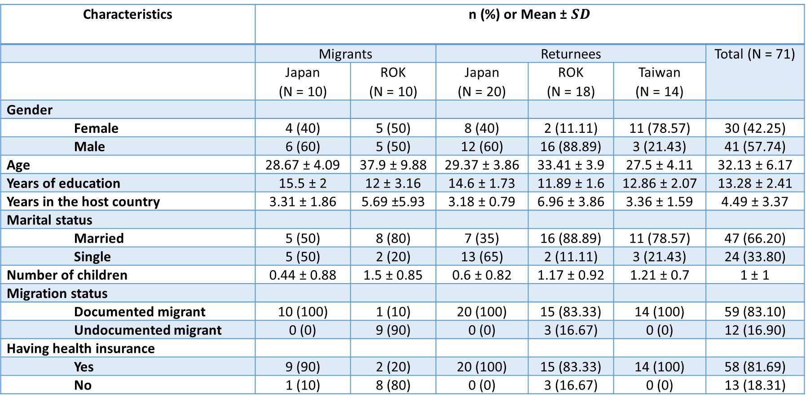
Participants’ characteristics
Characteristics | n (%) or Mean ± $SD$
 | Migrants |  | Returnees |  |  | Total (N = 71)
 | Japan (N = 10) | ROK (N = 10) | Japan (N = 20) | ROK (N = 18) | Taiwan (N = 14)
Gender
Female | 4 (40) | 5 (50) | 8 (40) | 2 (11.11) | 11 (78.57) | 30 (42.25)
Male | 6 (60) | 5 (50) | 12 (60) | 16 (88.89) | 3 (21.43) | 41 (57.74)
Age | 28.67 ± 4.09 | 37.9 ± 9.88 | 29.37 ± 3.86 | 33.41 ± 3.9 | 27.5 ± 4.11 | 32.13 ± 6.17
Years of education | 15.5 ± 2 | 12 ± 3.16 | 14.6 ± 1.73 | 11.89 ± 1.6 | 12.86 ± 2.07 | 13.28 ± 2.41
Years in the host country | 3.31 ± 1.86 | 5.69 ±5.93 | 3.18 ± 0.79 | 6.96 ± 3.86 | 3.36 ± 1.59 | 4.49 ± 3.37
Marital status
Married | 5 (50) | 8 (80) | 7 (35) | 16 (88.89) | 11 (78.57) | 47 (66.20)
Single | 5 (50) | 2 (20) | 13 (65) | 2 (11.11) | 3 (21.43) | 24 (33.80)
Number of children | 0.44 ± 0.88 | 1.5 ± 0.85 | 0.6 ± 0.82 | 1.17 ± 0.92 | 1.21 ± 0.7 | 1 ± 1
Migration status
Documented migrant | 10 (100) | 1 (10) | 20 (100) | 15 (83.33) | 14 (100) | 59 (83.10)
Undocumented migrant | 0 (0) | 9 (90) | 0 (0) | 3 (16.67) | 0 (0) | 12 (16.90)
Having health insurance
Yes | 9 (90) | 2 (20) | 20 (100) | 15 (83.33) | 14 (100) | 58 (81.69)
No | 1 (10) | 8 (80) | 0 (0) | 3 (16.67) | 0 (0) | 13 (18.31)

Slide 33
Challenges in accessing information and health care services
Financial barriers
Social support barriers
Structural barriers
Cognitive barriers

Slide 34
Key challenges in health care access
Cognitive barriers
Lack of knowledge about benefits of health insurance for COVID-19 testing and treatment
Lack of knowledge about healthcare system in the destination country
Work (earning) outweighs migrants’ perceived benefits of preventative healthcare access

Slide 35
“I don’t know whether my health insurance can be extended for those who are waiting for visas to go back to Viet Nam due to the pandemic…”
(Male, 32, returnee from ROK, E9 visa holder, manufacturing industry)

Slide 36
“I wanted to find it out [about visa issues] but I didn’t know where to find it. I often opened pages of Vietnamese communities in Japan, people often learned about it and asked visa-related questions. I don’t know where to find the correct information.”
(Returnee from Japan, 25, female, working in machinery)

Slide 37
Key challenges in health care access in ROK/Japan
Financial barriers
High out of pocket costs associated with COVID testing and treatment
Lack of health insurance particularly among undocumented migrants
Financial burden on migrants due to lack of regular income

Slide 38
“Yes, the most difficult thing is I don't have papers [legal documents], so the hospital fees and medicine costs will be high, and I will have to pay a lot.”
(Returnee from ROK, 37, male, working in machinery)

Slide 39
Key challenges in health care access in ROK/Japan
Structural barriers
Lack of interpretation services/Language barriers
Location of health-care facilities and transportation
Limited capacity of health-care facilities due to high burden of COVID-19 cases
Irregular status of migrants
Lack of official employment contracts
Time conflict or tight schedule

Slide 40
“I faced difficulty when I went for my antenatal check-ups as I didn’t know the language, which was quite difficult.”
(Returnee from Taiwan, 22, female, working in food manufacturing)

Slide 41
Key challenges in health care access in ROK/Japan
Social support barriers
Lack of support from employers (e.g. employers do not allow migrants to take sick leave. Migrants are asked to undertake dangerous work by employers and cannot seek healthcare)

Slide 42
“Before I went there, the company said that I would have my health checked every six months, two times per year. However, it would be more than two years since I went there, I had no health check-up. When I just arrived, the union let me get a health check-up. However, after that, I worked at the company, I didn’t have any health check-ups.”
(Female, returnee from Japan, technical intern, manufacturing industry)

Slide 43
Challenges in access to information for migrants in ROK/Japan
Language barriers
Limited source of information (migrants often collect information through unofficial channels e.g. facebook group pages)
Lack of response from the Embassy of Viet Nam in the destination country (migrants called the embassy, but they did not pick up a phone)

Slide 44
“I went back home amid the pandemic. The difficulty was I didn’t know the order of the procedure to proceed. At that time, it was very difficult to fill out a document to return. I did it several times. I did it myself which was not correct. The resident law in ROK changed often that I couldn’t understand.”
(Male, 35, returnee from ROK, E9 visa holder, manufacturing)

Slide 45
"It is quite difficult because I don’t understand information disseminated by Japanese government. Information from Facebook pages of the Vietnamese association is just sketchy."
(Male, 32, returnee from Japan, technical intern, manufacturing industry)

Slide 46
Facilitator to health care access
High quality of health-care including friendly health-care workers
Having health insurance
Migrant-friendly policy in response to COVID-19 pandemic (e.g. inclusion of migrants in the vaccine roll out programme)
Interpretation services
Support from CSOs/NGOs particularly in ROK
Support from employers (e.g employers helped migrants made an appointment and provide transportation etc)
Support from friends and relatives
Support from Vietnamese embassy, associations, community

Slide 47
“The healthcare services were quite good. After being checked and I waited for 15 minutes, they returned the results of the examination. There, every customer was like “God” to them, I went for health check-ups just like a Japanese, all were the same. I see healthcare services are already good in Japan, I have no comment.”
(Returnee from Japan, 32, male, working in construction)

Slide 48
Migrants’ challenges from stakeholders’ perspectives
Structural barriers
Financial barriers
Cognitive barriers

Slide 49
Structural barriers
Language barriers
Limited access to health-care due to tight working schedules
Restriction in accessing health-care due to COVID-19
Expiration of duration of sojourn during the COVID-19 pandemic

Slide 50
Financial barriers
Irregular status of migrants
Lack of health insurance
Financial burden related to COVID-19 testing and treatment
Notes:
The quote is extracted from MRC Quang Ngai. However, I think we should not discrete their location.

Slide 51
Cognitive barriers
Less paid attention on health-care (non-proactive migrants)
Lack of understanding on the health-care system of the destination countries

Slide 52
“They [labour migrants] may not be aware of those issues before departure and may not receive a thorough consultation about health care services and health regulations and laws in the destination countries.”
Migrant Resource Centre, Viet Nam

Slide 53
Barriers to assisting Vietnamese labour migrants
Service delivery
+ Inconsistent guidance in administration of COVID-19 vaccines for migrants
+ Loss of migrants' contact upon arrival in destination countries
Organizational structure
+ Language barriers
+ Limited capacity of stakeholders
+ Shortage of human resources

Slide 54
Discussion and recommendations
Recommendations to employers
Advocate employers to support basic social welfare for migrant workers (e.g mandatory provision of health insurance and medical checkup. Support migrant health through equitable sick leave).
Monitor employers’ implementation of labour laws such as failure to provide social welfare including health insurance, sick leave etc.

Slide 55
Discussion and recommendations (cont)
Recommendations to host governments
Host governments need to consider to implement a flexible policy allowing migrants to work with health insurance for easing their financial burden after expiration of their work permit while waiting to return to Viet Nam.
Notes:
Only a small number of migrants reported receiving any guidance on public health emergency situations in Viet Nam before their departure to ROK.
Around 30% of migrants in ROK did not attend a pre-departure training on how to protect their health during their overseas work.

Slide 56
Discussion and recommendations (cont)
Recommendations to Vietnamese government and recruitment agencies
Need to standardize a pre-departure training curriculum on promoting the health of overseas migrants especially in the context of public health emergencies
Establish a mechanism to ensure the provision and quality of pre-departure trainings
Develop a unified news source on Facebook and/or Zalo which combines verified information of basic healthcare services, COVID-19 and other emergency issues, migration issues and legal support

Slide 57
Discussion and recommendations (cont)
Sending agencies and broker services should better prepare prospective migrant workers for:
  language & social adaptation skills
  social networking with Vietnamese communities in the host countries
  information and help seeking skills (e.g. healthcare, migration issues, emergency situations etc)

Slide 58
THANK YOU

